Slide 1
PROBLEM STATEMENT
OBJECTIVE:
To develop a comprehensive Power BI dashboard for the e-commerce sales team that provides real-time insights into sales performance, product performance, geographical distribution, shipping efficiency, and overall financial health. The goal is to enable data-driven decision-making to improve sales strategies, optimize inventory management, enhance customer satisfaction, and increase profitability.
Current Situation: The e-commerce business has been collecting extensive sales data, including details on orders, shipping, customer demographics, products, and financial metrics. However, the data is currently siloed in Excel spreadsheets, making it challenging to derive actionable insights quickly and efficiently. There is a need to consolidate this data into an interactive dashboard that can provide a holistic view of the business performance.
Challenges:
Lack of centralized and real-time visibility into key sales metrics.
Difficulty in tracking and analyzing customer behavior and segments.
Inadequate insights into product performance and inventory status.
Limited understanding of geographical sales distribution.
Inefficiencies in shipping and order fulfillment processes.
Challenges in measuring the financial impact of discounts and promotions.

Slide 2
PROBLEM STATEMENT
KPI Requirements
Sales Overview
Total Sales: Total revenue generated from sales.
Total Orders: Total number of orders placed.
Average Order Value: Average value of each order (Total Sales / Total Orders).
Sales Trend Over Time: Monthly/Yearly sales trends to identify seasonal patterns and growth rates.
Customer Analysis
Customer Segments: Distribution of customers across segments (Consumer, Corporate, Home Office).
Top Customers: List of top customers by sales revenue.
New vs. Returning Customers: Proportion of new customers versus returning customers.
Product Performance
Top-Selling Products: Products with the highest sales revenue.
Sales by Category/Sub-Category: Breakdown of sales by product categories and sub-categories.
Product Profitability: Profit margins for each product (Profit / Sales).

Slide 3
PROBLEM STATEMENT
KPI Requirements
4. Geographical Insights
Sales by Region/Country: Revenue distribution across different regions and countries.
Top Cities: Cities with the highest sales revenue.
5. Financial Metrics
Total Profit: Total profit generated (Sales - Costs).
Profit by Category: Profit distribution across different product categories.
Discount Impact: Analysis of how discounts are affecting sales and profit margins.

Slide 4
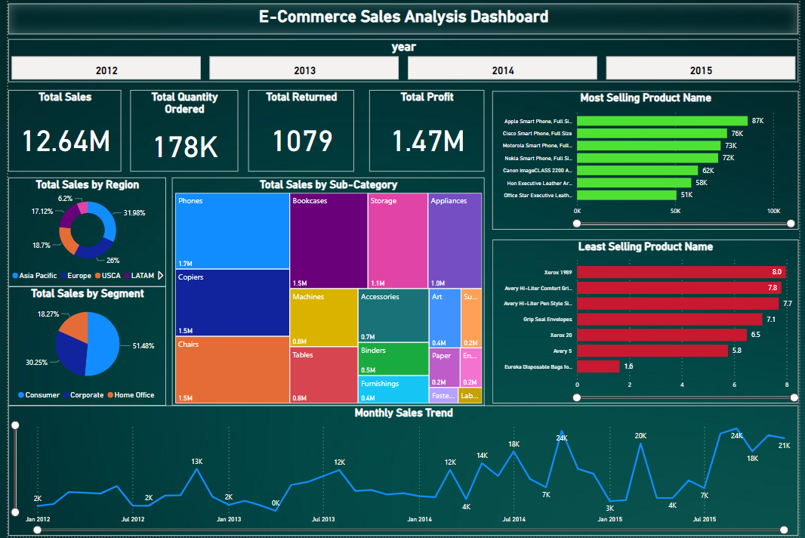
SALES OVERVIEW

Slide 5
SALES OVERVIEW
Above dashboard displays information about sales performance over a four-year period, from 2012 to 2015. Here’s a breakdown of the key metrics displayed on the dashboard:
Dashboard contains the slicer with which we can filter years.
The Dashboard displays metrics like total sales, total quantity ordered, total returned and total profit for each year.
Sales By Region:
It shows that the largest portion of sales came from Asia pacific region (i.e. 31.98% of sales), followed by Europe and USCA.
Sales By Segment:
It shows that the consumer segment contributed the most to sales at 51.48%, Followed by Corporate Home Office at 30.25%.
Dashboard also shows total sales by product’s subcategory.
We can also see the most selling and least selling product names.
In the Bottom we can see the monthly sales trend.

Slide 6
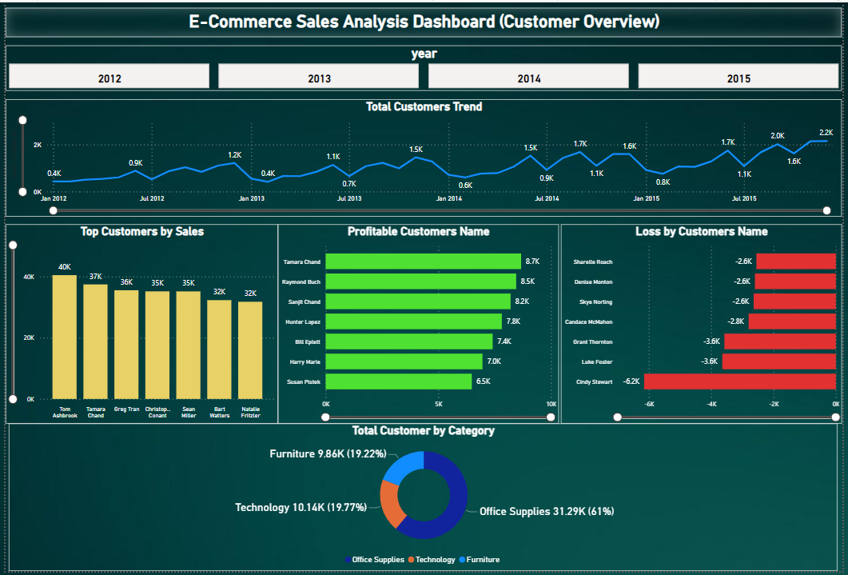
CUSTOMER OVERVIEW

Slide 7
CUSTOMER OVERVIEW
Above Customer overview dashboard displays information about customers over a four-year period, from 2012 to 2015. Here’s a breakdown of the key metrics displayed on the dashboard:
Customer Trend:
The line graph shows an upward trend in the total number of customers year-on-year. We can also see month-on-month customer trend in same line graph.
We can also see top customers by sales.
We can see from which customers we are making Profit and loss.
We can also see total customer by category.

Slide 8
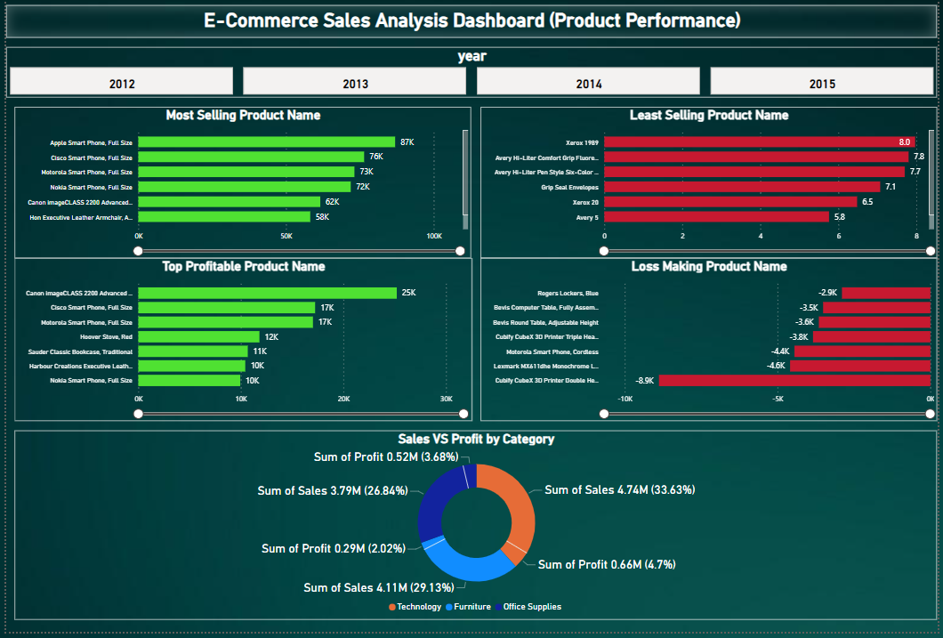
PRODUCT PERFORMANCE

Slide 9
PRODUCT PERFORMANCE
Above dashboard displays information about product performance over a four-year period, from 2012 to 2015. Here’s a breakdown of the key metrics displayed on the dashboard:
We can see,
Most Selling Product Name.
Least Selling Product Name.
Profitable products.
Loss Making Products.
Sales vs Profit by Category
The pie chart shows the total sales and total profit contribution for each product category: Technology, Furniture and Office Supplies.

